Slide 1
Software Requirements
Specification
Page 1
for
Auto Capture Selfie using Custom Gestures
Version 3.1 Decided
Prepared by
Advait Gaur (B22CS004)
Aniket Singh(B22CS004)
IIT JODHPUR
27th April 2024

Slide 2
Page 2
Table of Contents
1.Introduction
Purpose
Document Conventions
Intended Audience
Product Scope
References
2.Overall Description
Product Perspective
Product Functions
System Functions
Other functionality
Operating Environment
3.External Interface Requirements
User Interfaces
Hardware Interfaces
Software Interfaces
4.System Features
Gesture Detection Selfie capture
5.Summary

Slide 3
Page 3
Revision History
Date | Reason For Changes | Version
20-Feb | To improved gesture recognition accuracy and performance optimizations. | 1.0
28-Feb | Adding more gesture in YOLOV8 | 1.1
10-March | Issue in Realtime implementation | 1.2
22-March | Optimization of Haar cascade model | 2.0
10-April | Lack of quantization and unable to deploy in Kotlin environment | 2.1
17-April | Enhancing UI elements with more gestures added with Unit Testing required | 3.0

Slide 4
Page 4
Introduction
1.1 Purpose
This document serves as the Software Requirements Specification (SRS) for the "Gesture-Based Selfie Capture App," developed using Kotlin version 7 or higher and integrating a TensorFlow Lite (TFLite) model, specifically EfficientDet-D0, for gesture detection. The primary goal of this document is to outline the functionalities and requirements of the app in detail.
1.2 Document Conventions
The font that is followed in this document is arial and its size is 16. Special highlighting is done by making the text bold so that important keywords can easily be differentiated. Every requirement stated in this document has its own unique priority and every functionality is equally important.
1.3 Intended Audience
The intended audience for this document includes the development team responsible for building and maintaining the Gesture-Based Selfie Capture App. This team should have expertise in Kotlin, TensorFlow Lite, and TFLite models to understand and implement the outlined requirements effectively.
Additionally, stakeholders such as users, testers, and project managers involved in the app's development and deployment are also part of the intended audience. Their feedback and insights will be valuable for refining and improving the app's functionality and user experience.

Slide 5
Page 5
1.4 Product Scope
The Gesture-Based Selfie Capture App aims to provide users with a seamless and interactive experience by leveraging gesture detection technology. Specifically, the app will automatically capture selfies based on detecting predefined gestures such as smiles, heart hands, victory signs, and thumbs-up gestures.
Key features of the app include:
Gesture Detection: Utilizing the EfficientDet-D0 model for accurate and efficient gesture recognition.
Selfie Capture: Automatically capturing selfies when the app detects predefined gestures.
Real-Time Feedback: Providing real-time feedback to users during gesture detection for enhanced usability.
User Interface: Designing an intuitive and user-friendly interface for seamless interaction with the app.
Compatibility: Ensuring compatibility with Kotlin version 7 or higher for optimal performance and reliability.
The app's scope extends to users who want to capture selfies effortlessly using gesture recognition technology. It aligns with modern trends in mobile app development and offers a unique and engaging experience for users.
1.5 References
The document refers to the following assignments submitted:
Lecture-2 Software Engineering
ISO/IEC/IEEE 29148:2018(en) Systems and software engineering — Life cycle processes — Requirements engineering
https://www.iso.org/obp/ui/en/#iso:std:iso-iec-ieee:29148:ed-2:v1:en

Slide 6
Page 6
Overall Description
2.1 Product Perspective
The Gesture-Based Selfie Capture App is a standalone product designed to enhance user experience by automating selfie capture through gesture recognition technology. It is not a replacement for existing systems but rather a new, innovative solution in the mobile app market. The app operates independently, requiring no integration with other systems or products.
A simple diagram illustrating the major components of the app, such as the gesture detection module, selfie capture functionality, user interface, and external interfaces (if any), can provide a visual understanding of its architecture and interactions.
2.2 Product Functions
Gesture Detection: The app must accurately detect predefined gestures such as smiles, heart hands, victory signs, and thumbs-up gestures.
Selfie Capture: Automatically capture selfies when the app detects the specified gestures.
Real-Time Feedback: Provide users with real-time feedback during gesture detection to enhance user experience.
User Interface: Design an intuitive and user-friendly interface for seamless interaction with the app.
A top-level data flow diagram or object class diagram can visually represent the major functions and their relationships within the app.

Slide 7
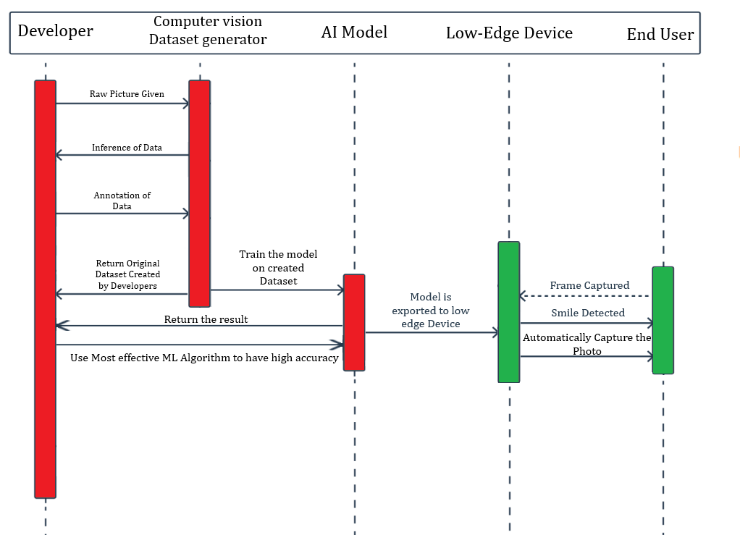
Page 7
The system shall process visual data. It will begin by accepting a raw image for input. Pre-processing steps, including noise reduction and image sharpening, may be applied to enhance the data. Developers will create a dataset for training, and the system will subsequently train a model using this data. The trained model can then be exported to a low-powered device for deployment. This device will capture frames of visual data, and the system will perform inference on these frames to extract insights. The system should return results based on the analysis, such as smile detection within a captured frame. Additionally, the system might be equipped to automatically capture photos.

Slide 8
Page 8
2.3 System Functions
Gesture Detection
The app must accurately detect predefined gestures, including smiles, heart hands, victory signs, and thumbs-up gestures.
Utilize the EfficientDet-D0 model for gesture recognition.
Selfie Capture
Automatically capture a selfie upon successful detection of a specified gesture.
Save the captured selfie to the device's gallery.
User Interface
Design an intuitive and user-friendly interface with clear instructions for gesture capture.
Storage Management
Implement efficient storage management to prevent excessive use of device storage.
Enable users to view their captured selfies within the app.
Offline Mode
Ensure basic app functionalities such as gesture detection and selfie capture work offline.
2.4 Others functionality
Performance
The app must have minimal latency in gesture detection and selfie capture.
It should operate smoothly on devices with varying hardware capabilities.
Usability
The user interface should be intuitive and easy to navigate.
Reliability
The app should consistently detect gestures accurately under different lighting and environmental conditions.
Ensure that selfie capture is reliable and does not result in lost or corrupted images.

Slide 9
Page 9
Scalability
Implement scalable backend infrastructure to support data storage needs.
We can add up to 50+ models in near future
Compliance
Adhere to privacy regulations and guidelines regarding user data collection, storage, and sharing.
Ensure compliance with platform-specific app store policies and requirements.
Compatibility
The app should be compatible with a wide range of Android devices running Kotlin version 1.9.23 or higher.
Ensure compatibility with different screen sizes, resolutions, and Android OS versions..

Slide 10
Page 10
2.5 Operating Environment
The software stack for development includes Kotlin 1.9.23 and Android Studio, facilitating the integration of a TensorFlow Lite (TFLite) model based on the EfficientDet-D0 architecture. The app will be published to the Google Play Store using a developer account.
The system will be built with the help of following software:
Environment for development
Sr No | System | Environment for development | Description
1. | Software used to develop | Frontend: Kotlin 1.9.23 | Kotlin 1.9.23 in frontend development is about using Kotlin for creating user interfaces and client-side functionality, offering robust features, concise syntax, and interoperability with Java libraries.
 |  | Model: Tflite Model | The Tflite model employs the EfficientDet-D0 architecture, which is a state-of-the-art object detection model optimized for efficient performance and accuracy in computer vision tasks.
 |  | IDE: Android Studio (student version) | The IDE being used is Android Studio, specifically the student version, which is equipped with Kotlin support. This combination empowers students to develop Android applications efficiently and take advantage of Kotlin's modern features for a seamless development experience.

Slide 11
Page 11
 |  | Version Control: Git, GitHub | GIT is a version-control system for tracking changes in computer-files and coordinating work on those files among multiple people.
 |  | Web Editor: - Google Colab | A web-based editor ideal for collaborative coding, particularly suited for Python-based projects like data science and machine learning.
 |  | Usage of system library for unit testing: Kotlin- unit test | In Kotlin unit testing, the system library is used to mock system-level behavior and dependencies, facilitating isolated and efficient testing of code components.
5. | Server hosting/ Installation (user testing) | The app will be published to the Google Play Store using a developer account. | The Google Play Store is Google's official platform for distributing Android apps, games, media, and more. Developers publish their creations here for Android users to download and enjoy, making it a central hub for digital content on Android devices.

Slide 12
Page 12
3 External Interface Requirements
3.1 User Interfaces
The user interface of the Gesture-Based Selfie Capture App will exhibit the following characteristics:
Screen Layout: The layout will be intuitive and user-friendly, with clear buttons for gesture detection and selfie capture.
Sample Screen Images: Sample screen images will be provided in the.
GUI Standards: The app will adhere to industry-standard GUI guidelines for mobile applications, ensuring consistency and ease of use across different devices..
Error Message Display: Error messages will follow standard formatting and will be displayed prominently to guide users in troubleshooting issues.
3.2 Hardware Interfaces
The Gesture-Based Selfie Capture App will interface with the hardware components of mobile devices, including:
Supported Devices: The app will be compatible with smartphones and tablets running Android OS version 7 or higher and iOS version 14 or higher.
Data and Control Interactions: The app will interact with device hardware to access the camera for selfie capture and sensors for gesture detection.
Communication Protocols: Standard communication protocols such as USB, Bluetooth, and Wi-Fi will be utilized for seamless interaction between the app and external hardware peripherals.

Slide 13
Page 13
3.3 Software Interfaces
The app will interface with the following software components:
Operating Systems: Android OS version 7 or higher and iOS version 14 or higher.
Tools and Libraries: TensorFlow Lite (TFLite) for gesture detection using the EfficientDet-D0 model.
Integrated Commercial Components: Integration with social media platforms (optional) for sharing selfies.
Data Sharing: Data sharing between software components will follow standard protocols and formats, ensuring compatibility and secure data transfer.

Slide 14
Page 14
System Features
4.1 Gesture Detection
4.1.1 Description and Priority
This feature involves accurately detecting predefined gestures such as smiles, heart hands, victory signs, and thumbs-up gestures. It is of high priority as it forms the core functionality of the app, enabling users to interact with the app through gestures.
4.1.2 Stimulus/Response Sequences
User performs a gesture (e.g., smile, heart hands).
System captures the gesture through image processing.
System analyzes the gesture using the EfficientDet-D0 model.
If the gesture matches predefined patterns, the system triggers the selfie capture process.
System provides real-time feedback to the user during gesture detection.
4.1.3 Functional Requirements
REQ-1: The system shall have a gesture recognition module capable of identifying predefined gestures accurately.
REQ-2: The system shall utilize the EfficientDet-D0 model for gesture analysis and recognition.
REQ-3: The system shall provide real-time feedback to the user during gesture detection to ensure user engagement.
REQ-4: The system shall trigger the selfie capture process upon successful recognition of a predefined gesture.
REQ-5: The system shall optimize gesture detection algorithms for efficient performance on mobile devices.

Slide 15
Page 15
4.1.4 Non-Functional Requirements
REQ-NF-1: The system shall detect gestures and trigger selfie capture within 1 second of gesture recognition to provide a seamless user experience.
REQ-NF-2: The system shall have a gesture recognition accuracy of at least 95% to ensure reliable gesture detection.
REQ-NF-3: Security
The system shall encrypt user data during gesture detection and selfie capture processes to maintain user privacy.
REQ-NF-4: Scalability
The system architecture shall be designed to handle increased user traffic and future updates without performance degradation.
4.2 Selfie Capture
4.2.1 Description and Priority
This feature involves automatically capturing selfies when the system detects specific gestures. It is of high priority as it directly fulfills the primary functionality of the app.
4.2.2 Stimulus/Response Sequences
User performs a gesture recognized by the system.
System triggers the selfie capture process.
System captures a selfie using the device's camera.
System provides feedback confirming successful selfie capture.
4.2.3 Functional Requirements
REQ-1: The system shall automatically capture selfies upon successful recognition of predefined gestures.

Slide 16
Page 16
REQ-2: The system shall utilize the device's camera to capture selfies with optimal quality.
REQ-3: The system shall save captured selfies to the user's device gallery.
REQ-4: The system shall provide feedback confirming successful selfie capture to the user.
REQ-5: The system shall handle errors during selfie capture, such as camera failures or storage issues, by displaying appropriate error messages.
REQ-6: The system shall allow users to review and delete captured selfies within the app.
REQ-7: The system shall ensure user privacy and data security during selfie capture and storage.
4.2.4 Non-Functional Requirements
REQ-NF-1: The system shall capture and save selfies within 1 seconds of gesture-triggered capture to maintain user engagement.
REQ-NF-2: The system shall be compatible with a wide range of mobile devices, including smartphones and tablets running Android OS version 7
REQ-NF-3: The system shall efficiently manage and store selfies, optimizing storage space on the user's device without compromising image quality.

Slide 17
Page 17
5. Summary
This document outlines the Software Requirements Specification (SRS) for the "Gesture-Based Selfie Capture App" designed to run on mobile devices. The document is structured into five sections to provide a comprehensive understanding of the app's requirements and functionalities.
In the first section, the document introduces the purpose of the SRS, defines the scope of the app, outlines document conventions, and identifies the intended audience.
Section 2 details the product perspective, major functions, user classes, and characteristics. It also includes information about the operating environment, design and implementation constraints, key assumptions, and dependencies.
Section 3 elaborates on all interfaces required for the app, including user interfaces, hardware interfaces, software interfaces, and communications interfaces.
Section 4 delves into system features and their functional requirements. A priority matrix is included to highlight the importance of each feature, categorized as high, medium, or low priority. Functional requirements are presented in a table format for traceability and clarity.
Finally, Section 5 covers non-functional requirements, including performance, safety, security, software quality attributes, software backups, redundancy measures, and business rules relevant to the app's operation and usage.

